Slide 1
﷽

Slide 2
Balochistan Students Learning Improvement Programme
BSLIP

Slide 3
Training for English Language Primary
Facilitators:
Faryaal Khalid
Munazza Gul

Slide 4
Workshop Objectives!

Slide 5

Utilize the English textbook in lesson planning and classroom activities.
Incorporate formative assessment techniques in reading, writing and Grammar teaching to monitor and support student progress.
Develop and apply writing instruction techniques for primary level students.
Integrate catch-up strategies (TARL) into daily lessons to support students lagging in language skills.
Implement effective reading and comprehension strategies for primary students for enhancing their learning.
Apply effective grammar teaching methods and activities tailored to primary students.
Create practical, low-cost teaching aids and activities for English language instruction.

Slide 6
Energizer!

Slide 7
I See I Think I Wonder

Slide 8


Slide 9


Slide 10


Slide 11


Slide 12


Slide 13
Reflect and share:
Q. What are the goals of teaching English?
Q. Where can we find specific directions and guidelines about the teaching of English?
Q. What would be your role and responsibility?

Slide 14
Unit 1 Navigating Core Resources: English Curriculum and Textbook

Slide 15
Unit 1 Objectives
Identify the key components of the English curriculum, including competency standards, benchmarks, and student learning outcomes.
Reflect on the significance of skill development in an English language classroom.
Examine how curriculum competencies are reflected in various sections of the English textbook and analyze specific sections while discussing related challenges.
Analyze specific sections of the textbook and discuss associated challenges.
Create strategies to tackle the identified challenges and optimize the textbook's use for skill development.

Slide 16
SNC Features
Uniformity-One Nation One Curriculum
Modern international trends
the SNC has our national and cultural values at its core
enhancing language skills i.e. listening, speaking, reading and
writing of the students.
Integration of Skills
Themes and sub-themes that promote values of peace and social cohesion
Innovative and student-centred activities

Slide 17







A key learning
area.
Competency
A standard defines the competency.
Each competency has different number of standards.
Standards
Benchmark
I-II
III-V VI-VII IX-X XI-XII
Benchmarks further elaborate the standards.
A benchmark progresses through developmental levels.
Benchmarks
Benchmark
SLO
SLOs are built on the descriptions of the benchmarks.
Each benchmark has different number of student learning outcomes.
Student Learning Outcomes (SLOs)
SLO
SLO

Slide 18
Competency
A competency is defined as a key learning area that involves applied skills and knowledge enabling learners to successfully perform in educational, professional and other contexts of life.

Slide 19
Standards
The standards define the competency by specifying broadly, the knowledge, skills and attitudes to be acquired by students in a particular key learning area during the first five years of schooling.

Slide 20
Benchmarks
The benchmarks further elaborate the expectations about what learners know under each standard, indicating what the students will accomplish at each of the developmental levels in order to meet the standards. These provide at a glance the continuum of the English language learning e.g. benchmarks for grade I and II define what the students will be able to do by the end of grade II.

Slide 21
Student Learning Outcomes (SLOs)
These are built upon the descriptions of the benchmarks and describe (in key points) what students will accomplish at the end of each unit. Most SLOs progress and develop across grades. Each skill is revisited, revised and reinforced. It is important to remember that SLOs within a competency or across competencies overlap and are interrelated; progress
towards one outcome is often dependent upon progress towards another e.g. writing skills are reinforced through reading and comprehension and vice versa.

Slide 22
Competency 1: Oral Communication Skills (Listening and Speaking) Standards 1, 2
Competency 2: Reading and Critical Thinking Skills Standards 1, 2
Competency 3: Formal and Lexical Aspects of Language Standards 1, 2
Competency 4: Writing Skills Standard 1
Competency 5: Appropriate Ethical and Social Development Standard 1

Slide 23
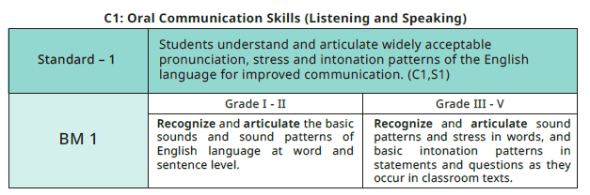
Articulate the
sounds of letters
of the alphabet
in random order.
Recognize and
articulate hard
and soft sounds
of the letters c
and g.
Pronounce and
practice simple
words with more
silent letters
such as ‘b‘ in
lamb.
Pronounce and
practice more
words with silent
letters such as ‘t’
in switch, ‘g’
sound in ‘high’.
Articulate the
sounds of letters
of the alphabet
in series and in
random order.

Slide 24

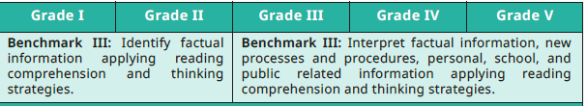
Express
understanding
of story
through
pantomime.
Express
understanding
of story through
pantomime
and simple
role play.
Express understanding of story through pantomime.
Express understanding of story through pantomime.
Relate what is read to their own experiences.
Express understanding of story through roleplay.
Relate what is read to their own experiences.

Slide 25
Activity
Curriculum Component Mapping

Slide 26
Work in 10 groups
Group Red
Group Blue
Group Green
Group Yellow
Group Orange
Group Purple
Group White
Group Brown
Group Pink
Group Peach

Slide 27
In groups, perform the following tasks:
1. Determine the competency
2. Identify the standard
3. Identify the benchmark(s)
4. Identify the SLOs
5. Identify SLOs progression from Grade I to V.
6. Write all the statements on Chart strips in a legible writing

Slide 28
Activity
Competency Commandos

Slide 29
Members from two groups will be invited to bring their statements written on chart strips.
On the facilitator's signal, they will paste the strips in order, starting from the Standard, followed by the Benchmark(s), and then the progressive SLOs from Grade I to V.

Slide 30
Red Oral Communication
All students will use appropriate social and academic conventions of spoken discourse for effective oral communication with individuals and in groups, in both informal and formal settings
Use some formulaic expressions for basic routine greetings and social courtesies for oral interaction in a predictable environment of class and school.
Listen and respond to a few commands.
Listen and respond to a more commands.
Respond to simple instructions and directions.
Respond to instructions and directions.
Give and Respond to instructions and directions.

Slide 31
Blue Oral Communication
Students understand and articulate widely acceptable pronunciation, stress and intonation patterns of English language for improved communication.
Recognize and articulate the basic sounds and sound patterns of English
language at word and sentence level.
Recognize and articulate sound patterns and stress in words, and basic intonation patterns in statements and questions as they occur in classroom texts.
Identify one syllable words that rhyme.
Identify and classify one and two syllable words that rhyme.
Recognize, demarcate and pronounce three and four syllable words.
Recognize and use the conventions to demarcate three and four syllable words.
Find out how many syllables a word has.

Slide 32
Green Group Reading and Critical Thinking
All students will search for, discover and understand a variety of text types through tasks which require multiple reading and thinking strategies for comprehension, fluency and enjoyment.
Use reading readiness strategies; recognize words and sentences as meaningful units of expression and paragraphs as graphical units of expression
Identify digraphs, silent letters and inflections in words; comprehend words, sentences and paragraphs as meaningful units of expression.
Read aloud three letter words with reasonable level of accuracy in pronunciation.
Read aloud words and simple sentences with reasonable level of accuracy in pronunciation.
Read aloud for accurate reproduction of sounds of letters and words.
Read aloud for accurate reproduction of sounds of letters and words.
Read silently for comprehension.
Read aloud for accurate reproduction of sounds in individual words and connected speech.
Read silently for comprehension.

Slide 33

Competency Commandos

Slide 34
Where have you seen these before?

Slide 35
Reading
Learning the Sounds
Oral communication
Vocabulary Building
Grammar
Creative Writing
Comprehension

Slide 36

These are sections and sub-sections from your textbook

Slide 37
Reflect back on the sections and sub sections! What competencies of SNC do these align with?

Slide 38
Reading
Learning the Sounds
Oral communication
Vocabulary Building
Grammar
Creative Writing
Comprehension

Slide 39
Which competencies these statements are catering to?

Slide 40
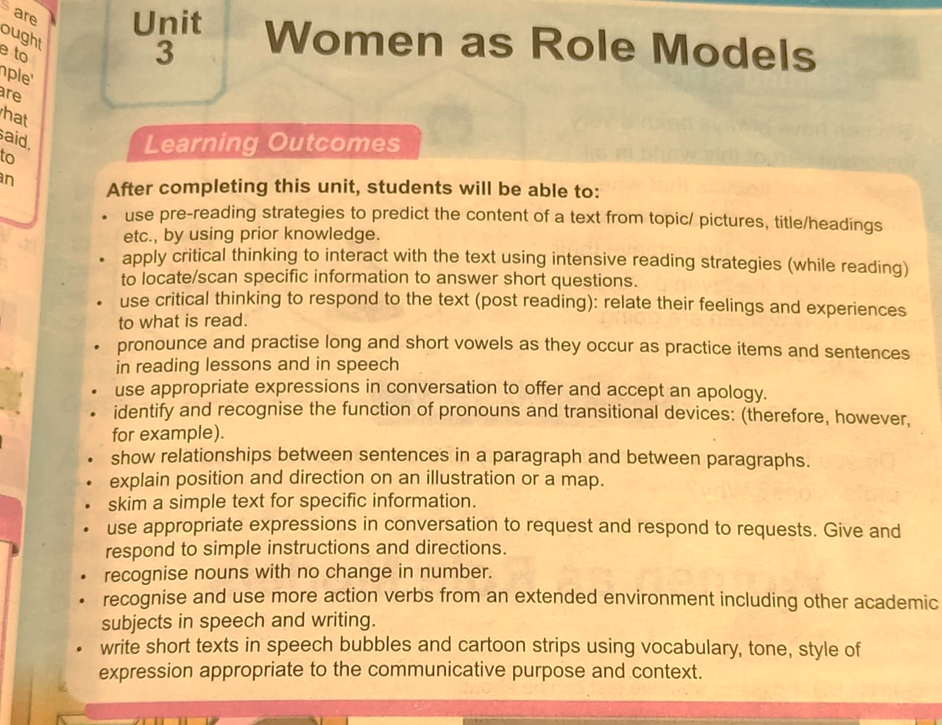

Slide 41
Are they a standard, a benchmark or an SLO?

Slide 42
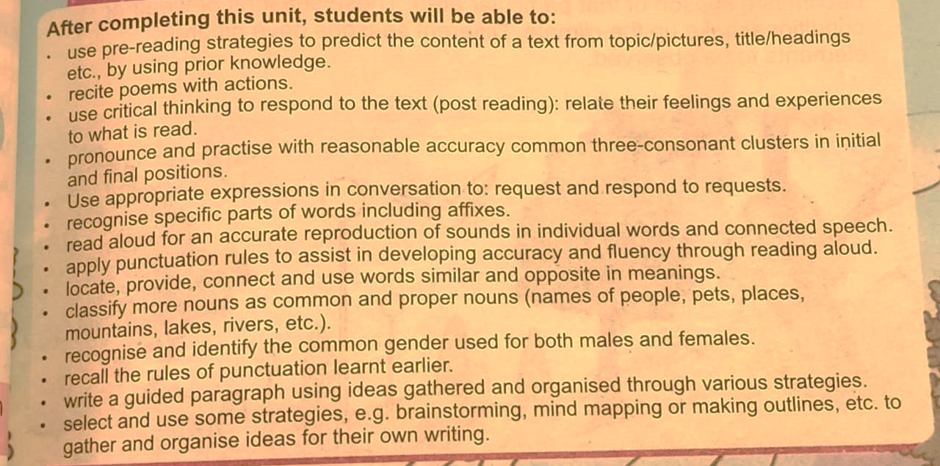

Slide 43
Textbook only has SLOs!

Slide 44
Participatory Learning
Work in 8 groups
Analyze specific section or sub-section.
Explore 5 units from your assigned section, using question cards.

Slide 45
Task
Discuss the challenges of teaching the assigned part of the textbook.
Develop strategies for effectively using this section in the classroom.
Exploring units using the question cards.

Slide 46
Time
20 minutes to complete the task.
Note down your findings and strategies on the chart paper.

Slide 47
Sections Assigned
Reading (Comprehension Text, Pre-Reading, While Reading, Post-Reading, and Reading Comprehension)
Learning the Sounds
Learning to Speak
Vocabulary Building
Learning to Spell
Grammar
Learning to Write
Creative Writing

Slide 48
Gallery Walk

Slide 49
1. Paste the charts on the walls. 2. Now, while working in groups, rotate around the room in clockwise manner. 3. Group 1 will start by reviewing the work of group 2 and so on. 4. Analyse what challenges and strategies the other groups have highlighted. 5. Move stations when the facilitator uses the whistle

Slide 50
Exploring Insights

Slide 51
overview of challenges and strategies for using textbook

Slide 52
Strategies for Effective Use of Textbook

Slide 53
1. Identify Overall Goals
Before teaching a new section, review and understand the language development goals and Student Learning Outcomes and how they align with your teaching strategies and students' needs.

Slide 54
2.Logical Sequencing and Integration of Exercises
Identify Key Skills
Start by identifying the core skills and concepts for each section. For instance, in reading, focus on comprehension strategies, vocabulary, and fluency.
Organize Exercises Sequentially
Arrange exercises from simple to complex. For example, in the phonics section, introduce basic sounds before moving to blends and digraphs. Ensure exercises build upon previous ones to reinforce learning.
Cross-Reference Across Pages
Review multiple pages to ensure related exercises are placed sequentially. For instance, in reading skills, ensure that all exercises related to the comprehension text are done in one go, no matter which section they are presented in the textbook.

Slide 55
3.Separate and Prioritize Activities
Grouping Connected Concepts
In each textbook section (e.g., Learning Sounds or Grammar), identify all relevant topics and subtopics. For instance, within nouns, include subtopics like common and proper nouns, singular and plural forms, and countable vs. uncountable nouns. This approach provides a comprehensive understanding of the subject matter.
Prioritizing Based on Grouping
Once concepts are grouped, establish a sequence for teaching them. Organize interconnected concepts from easy to complex, allowing teachers to determine which topics should be introduced first. This sequencing supports a logical progression in learning.
Parking Concepts
For pages with multiple concepts, some can be "parked" for future instruction. For example, rhyming words or sight words can be introduced on a specific day, with activities drawn from various sections of the textbook. Similarly, if a complex topic appears early, it may be beneficial to focus on foundational concepts first and revisit the complex topic later.

Slide 56
4.Standardization of Terminology
According to the National Curriculum, grammar concepts at the primary level have standardized vocabulary, such as "nouns" and "pronouns." While students may learn terms like "naming words" and "position words" in pre-primary settings, teachers should gradually shift to using standardized terms more frequently. If the textbook uses specific terminology interchangeably, it is essential for teachers to maintain consistent use of these standard terms to reinforce understanding and clarity in instruction.

Slide 57
5.Integration of English Language Skills
Connect Exercises Across Sections
Make conscious efforts to link activities across different sections of the textbook. For example, if the grammar section covers adjectives, students could be tasked with identifying adjectives in comprehension passages and using them in their writing and speaking activities.
Holistic Language Development Emphasize the interconnectedness of reading, writing, speaking, and listening skills. Activities should encourage students to use vocabulary learned in one context (like reading) in other contexts (like writing or speaking). This holistic approach supports deeper understanding and retention.

Slide 58
6. Adapt and Expand
Modify textbook exercises to better fit your classroom needs. For example, if a text includes tongue twisters as an exercise, turn it into a competition where teams practice and compete to see who can say them the fastest. If there are directions in the writing section, ask students to give directions to an object placed in the classroom using vocabulary from the textbook, like “turn left” or “walk straight.” Additionally, if the textbook features road signs, prepare sign cards and have the children line up to pretend they are riding a bus. As the "bus" moves, the teacher shows the signs, reinforcing understanding in a fun, interactive way. These adaptations make learning more engaging and practical for students.

Slide 59
7. Enhancing Practice and Variety
1. Increase Practice Time:
- Allocate Adequate Time: Ensure that each activity has sufficient practice time. For instance, dedicate more time to writing activities to allow for drafting, revising, and editing. Since textbooks may have limited exercises for practicing a concept, teachers should supplement this with additional activities using board work and charts to reinforce learning.
▪-Incorporate Regular Review: Schedule regular review sessions to reinforce concepts and skills learned previously. This helps in retaining and applying knowledge.

Slide 60
7. Enhancing Practice and Variety
2. Add Variety of Activities
▪-Incorporate Diverse Formats: Include a range of activity types such as games, group work, hands-on activities, and multimedia resources. For example, use phonics games, vocabulary bingo, or interactive story apps to keep students engaged.
-Beyond the Textbook: Integrate activities that extend beyond textbook exercises. For instance, use real-life scenarios for speaking practice or create interactive spelling challenges that allow students to apply what they've learned in practical contexts.
▪-Prepare Supplemental Materials: Create or gather additional materials that enhance understanding. For example, prepare visual aids, interactive exercises, or additional practice worksheets.

Slide 61
8.Review and Adjust
1. Identify and Address Gaps: Regularly review student progress to identify any gaps or challenges. Adjust your teaching strategies and materials accordingly to address these gaps.
2. Seek Feedback: Obtain feedback from students on what works well and what doesn’t. Use this feedback to refine your approach and improve the effectiveness of your lessons.

Slide 62
9. Invest in Personal Development:
Revise Key Concepts: Dedicate time to revise and deepen your understanding of essential concepts such as phonics, grammar, and vocabulary. This preparation will enable you to teach more effectively and confidently.
Engage with the Text: Read the text in advance and try writing paragraphs or stories to enhance your own reading and writing skills. This hands-on experience will help you understand the learning process from a student's perspective.
Explore Digital Resources: Utilize digital platforms and resources for self-improvement. Engaging with online workshops, webinars, and educational tools can further enhance your skills and teaching strategies.

Slide 63
Post Assessment

Slide 64
Task
Separate into 10 groups.
Use the cootie catcher to review the material.
Make sure all of the members get a turn.
You have 10 minutes for this activity.

Slide 65
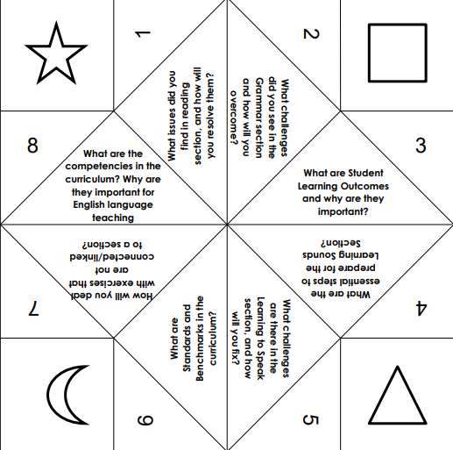

Slide 66


Slide 67
Unit 2 Mastering Grammar: Teaching and Assessment Strategies

Slide 68
Unit 2 Objectives
Explore the 3P Model (Presentation, Practice, Production) to grammar instruction effectively.
Acquire diverse methods for presenting grammar concepts in a context suitable for the primary level and catering to young learners' learning styles.
Engage in hands-on activities for practice and production, implementing creative strategies to enhance teaching and assessment of grammar.
Identify ways to integrate grammar across the four skills of language.
Reflect on their experiences and adapt the 3P Model for their own teaching contexts.

Slide 69
Instructions for Padlet
1.Think: Spend 2 minutes individually reflecting on the challenges you face when teaching English Grammar at the primary level.
2.Pair: After your reflection, pair up with a partner and discuss the challenges you identified. Together, compile a list of these challenges. You have 2 minutes for this discussion.
3.Share: After your discussion, you will receive a link via your WhatsApp group. Click on the link to access a Padlet page. Once there, click on the “+” sign to open a text box. Write down the key challenges you and your partner discussed, then click submit. You have 2-3 minutes to post your responses.

Slide 70
Checking for understanding
What challenges are you reflecting on during the "Think" step?
How much time do you have to think? (2 minutes)
What will you do during the "Pair" stage?
How much time do you have to discuss with your partner? (2 minutes)
What will you do after discussing with your partner?
Where will you write your responses? (On Padlet)
How will you post after accessing the Padlet link? (By clicking the “+” sign and submitting)

Slide 71
Pre-assessment

Slide 72
Participatory Learning A- Jigsaw

Slide 73
Participatory Learning A- Jigsaw
Home Groups:
1. Warriors
2. Champions
3. Gladiators
4. Dynamos
5. Legends
6. Knights
7. Conqueror

Slide 74
BUZZ AND BRIEF

Slide 75
Instruction
Question will be flashed on the PPT and groups can buzz in to participate.
The group that buzzes in first will get the chance to provide a 30-second commentary on the term displayed.
Scoring: The group that answers the most questions accurately will be declared the winner.

Slide 76
What is the stage where the teacher is introducing a concept?

Slide 77
What is the use of drilling?

Slide 78
What is the role of the teacher during the practice stage?

Slide 79
What is the realia? How can we use it?

Slide 80
Give one example how a song and a picture can be used to teach a concept?

Slide 81
What are some of the exercises that are used as controlled exercises?

Slide 82
What is the aim of the production stage?

Slide 83
How can surveys be used in the production stage? Give one example

Slide 84
Buzz and Brief

Slide 85
3 P MODEL

Slide 86
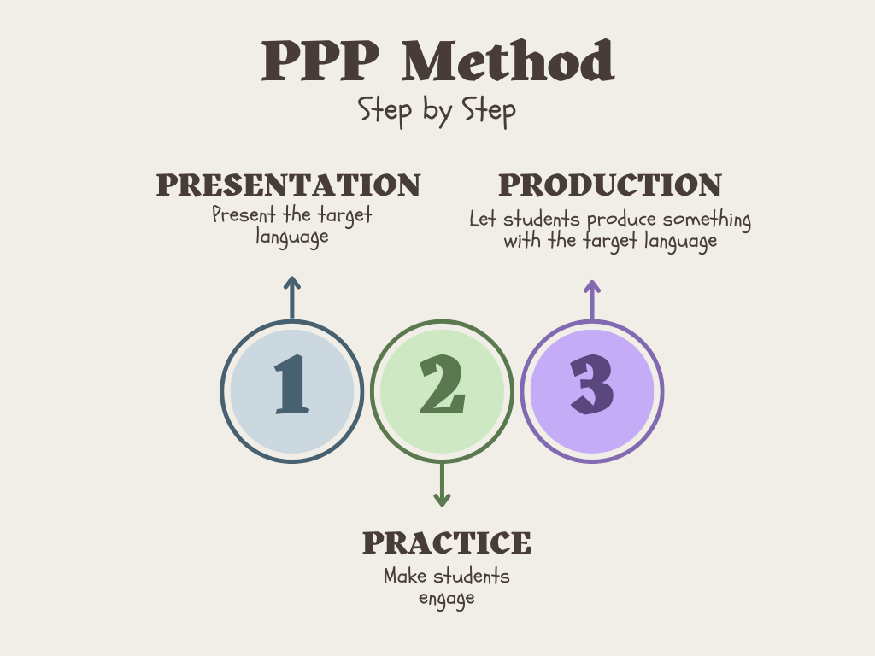

Slide 87
Instruction Grammar Carousel
Work in 5 groups, with each group consisting of 10 members.
Rotate between five stations.
Switch when the facilitator whistles.
Each group will work in sub-groups because each station has multiple activities.

Slide 88
Stations will include:
Station 1: Role Play, Survey, and Discussions
Station 2: Information Gap Activities
Station 3: Card Games
Station 4: Board Games
Station 5: Low-Cost Activities

Slide 89
Post-assessment

Slide 90
Instructions for Padlet
Access the "Two Stars and a Wish":
Click on the Padlet link via the temporary WhatsApp group.
You will see three columns: Stars (1), Stars (2), and One Wish.
Posting:
You will have 2-3 minutes to complete the posting.
In the first column (Star 1), click on the "+" sign, write your name and your first learning point, and click “Submit.”
In the second column (Star 2), click on the "+" sign, write your name and your second learning point, and click “Submit.”
In the third column (Wish), click on the "+" sign, write your name and your one area of growth/exploration related to the topic covered today, and click “Submit.”

