Slide 1
UNIT 4 Techniques for Developing Writing Skill

Slide 2
Bridge In-Word Cloud

Slide 3
Instruction for activity
1. Think: Spend 2 minutes individually reflecting on the challenges you face when teaching writing skills at the primary level.
2. Pair: After your reflection, pair up with a partner and discuss the challenges you identified.
3. Create a list of challenges.
4. Share: Click the link in the WhatsApp group.
5. Once there, only one person from the pair will type in the key challenges and click submit.
6. You have 2-3 minutes to submit your responses

Slide 4
Objectives

Slide 5
• Explore and apply guided writing techniques to support students in developing their writing from sentences to paragraphs.
• Use creative writing, including poems, to engage students and enhance their writing skills.
• Gain hands-on experience in writing paragraphs, focusing on topic sentences, supporting details, and overall structure.
• Engage in practical exercises to understand and apply the stages of the process approach (pre-writing, drafting, revising, editing) to enhance writing instruction.
• Design effective writing lessons incorporating guided writing, process approach strategies, and TARL principles.

Slide 6
Participatory Learning B- Poem Parade

Slide 7
Teacher Kind, Smart Working, Helping, Writing She loved to Read
Mrs. Sutton

Slide 8
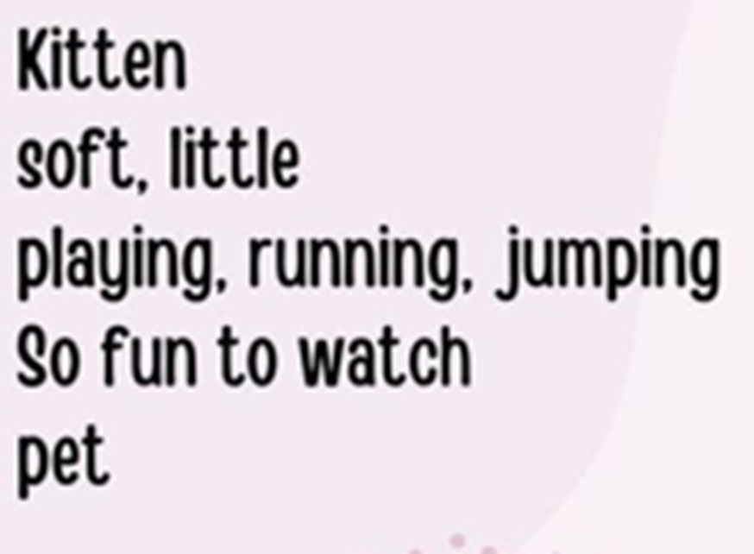

Slide 9
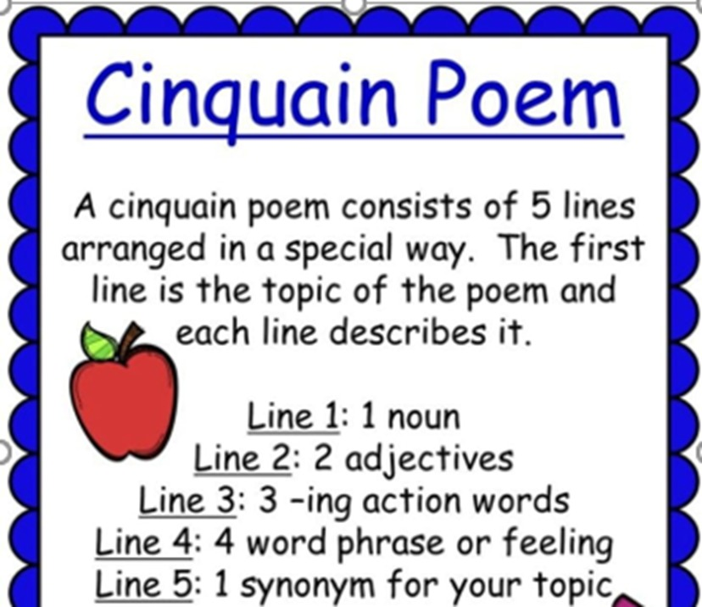

Slide 10
Instructions
Explore the poem template and example.
Then they will write a poem using the template.
Be creative but follow structure.
Write the final version on sticky notes along with their names and group title.
Paste their sticky note on a designated chart

Slide 11
Poetry Corner Walk

Slide 12
Participatory Learning D-Collaborative Writing

Slide 13
Instructions
Work in 8 groups.

Slide 14
Generating Ideas
Each group will select a topic and a strategy.
They will be given 2 minutes to collect ideas on their chosen topic using the selected strategy.
They will one side of a chart paper to write their group’s name, topic, and the ideas.

Slide 15
Writing the Paragraph
Groups will write a paragraph of at least 7-8 sentences.
They will write the final paragraph on the back of the chart, again using only one half of the chart paper.

Slide 16
Revision
Use the checklist provided to revise your paragraphs.
Use the second half of the chart to revise.

Slide 17
Editing
When you edit, clean your writing.
Read through the paragraph carefully.
Find and fix any mistakes before the next stage.
Use the checklists provided to you to help you in editing.

Slide 18
Round Robin Feedback
Groups will move clockwise.
Group will study the idea-generation activity and the two drafts of the paragraphs.
Using sticky notes, they will write comments to appreciate or suggest improvements.

Slide 19
Participatory Learning E- Mastering the Process Approach

Slide 20
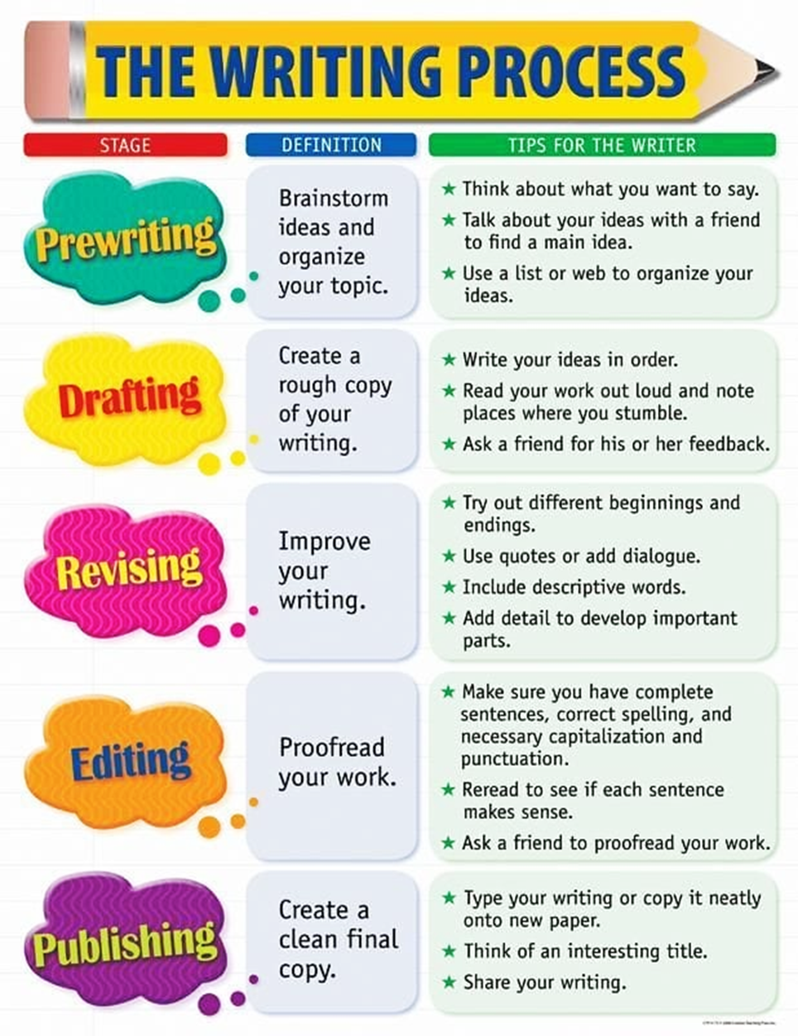

Slide 21
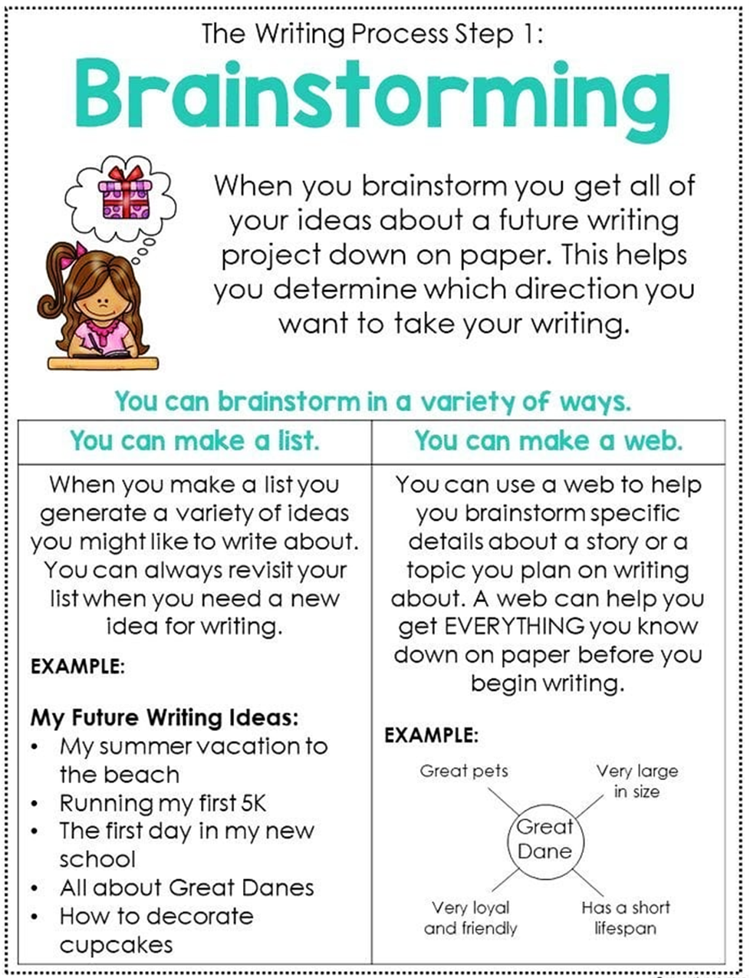

Slide 22
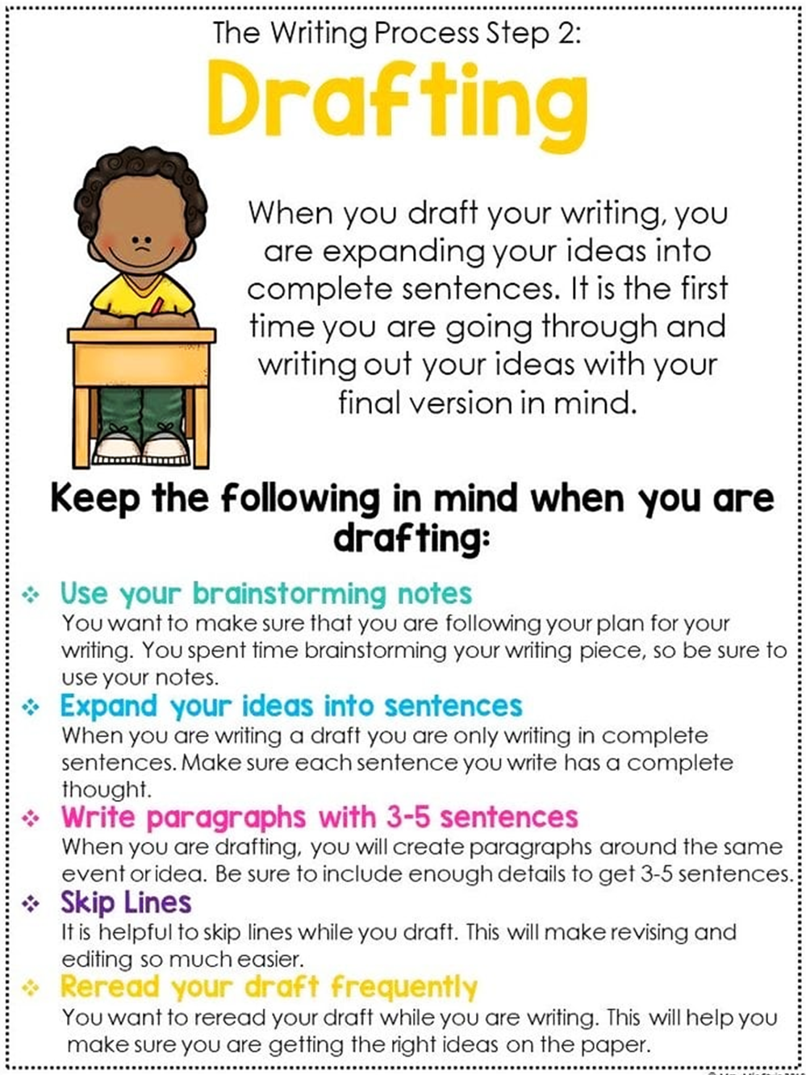

Slide 23
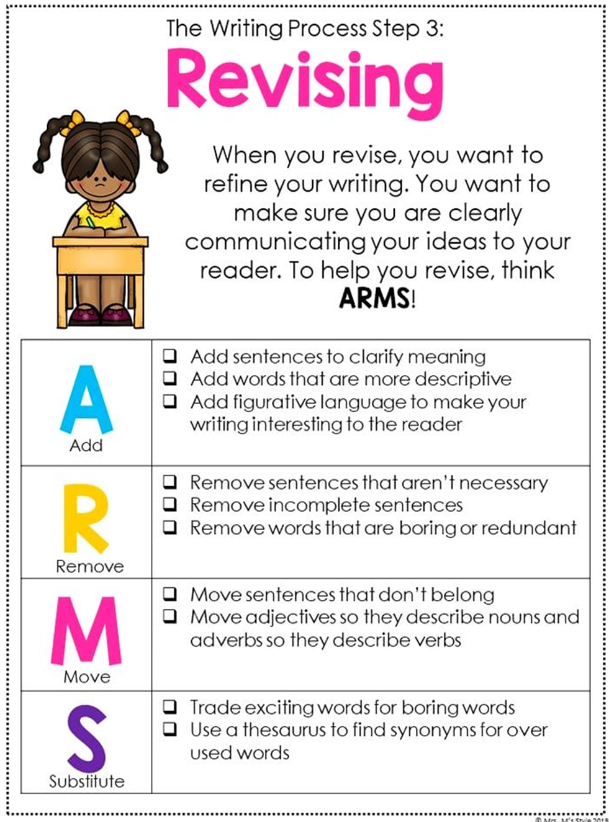

Slide 24
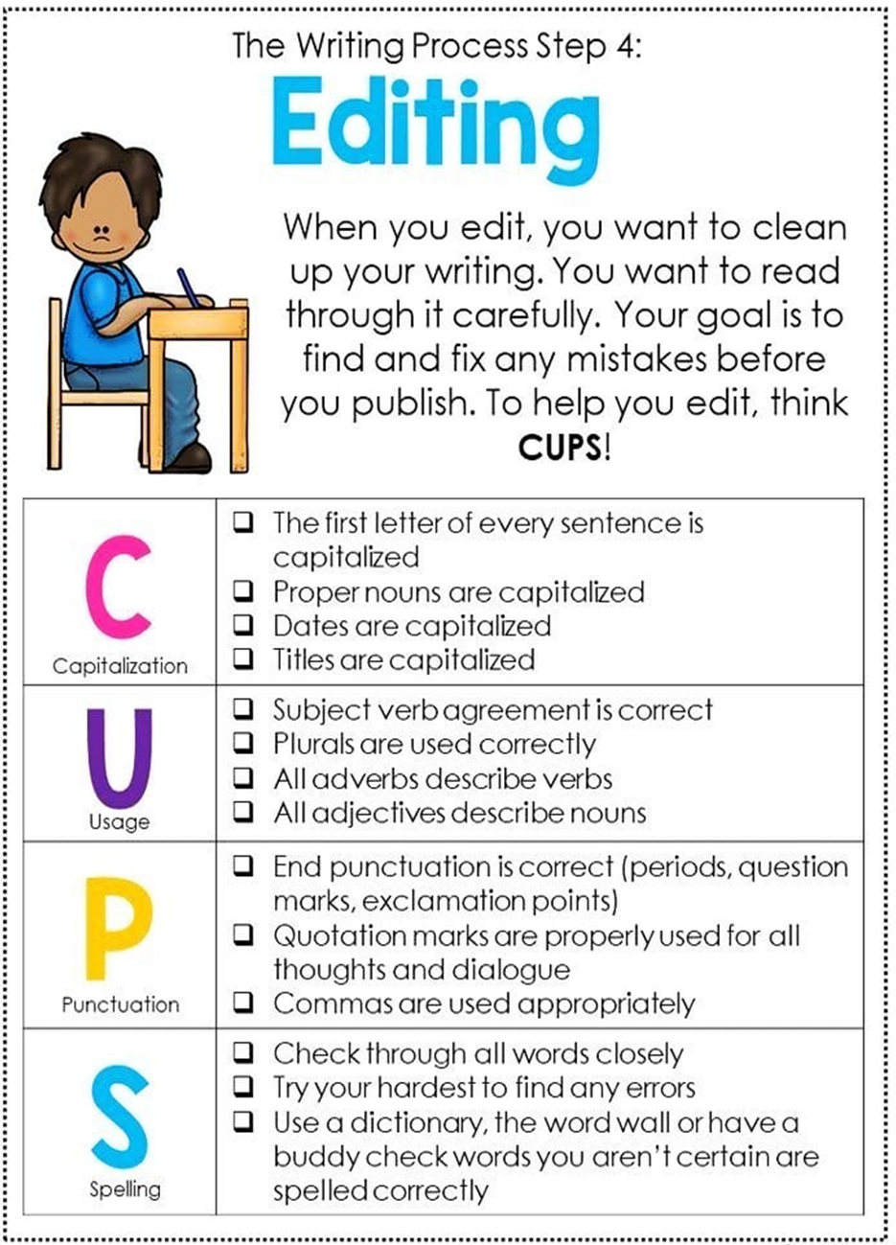

Slide 25
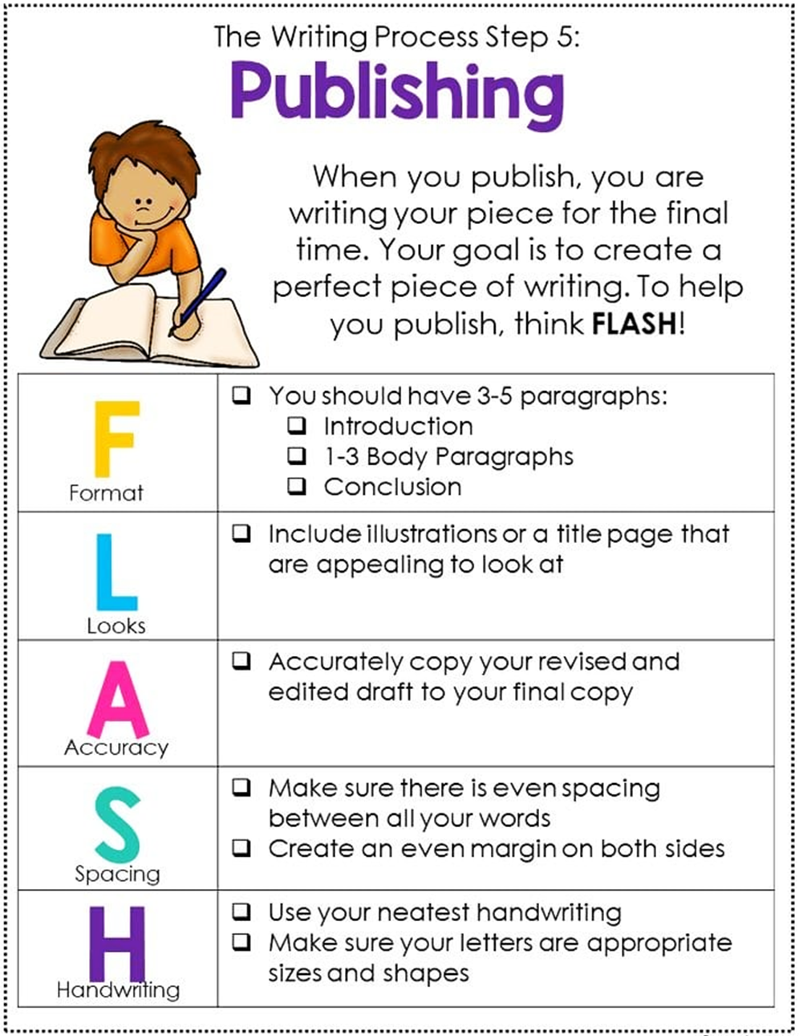

Slide 26
Participatory Learning A- Mastering Sentences: Guided Writing Techniques

Slide 27
What is a sentence?

Slide 28
The cat rode a bicycle to the moon to buy ice cream.
My shoes are friends with the rainbow, and they talk at night.
Ate the dog quickly its food.
Cake to I like eat.
The cat eated the fish.
He are playing football.

Slide 29
Sentence Stretching
•Who: Think of a character (person or animal) and write the name (e.g., "My brother," "My talking parrot").
•What: Write what the character is doing (e.g., "My brother is reading a book").
•How: Describe how the action is being performed (e.g., "He is reading the book quietly").
•Where: Indicate where the action is taking place (e.g., "In the living room").
•When: Mention when the action is happening (e.g., "In the evening").
•Why: Explain why the action is being performed (e.g., "Because he loves adventure stories").

Slide 30
Activity 2: Group Work - Exploring Sentence Writing Strategies

Slide 31
Instruction for Activity
Separate into 8 groups.
Each table has 6 different envelops.
Each one has a different sentence writing strategy.
One or two members will open and explore one envelop.
After they have explored, they will discuss.
Groups will discuss how effective these techniques will be for teaching sentence writing at the primary level.
You have 15 minutes for this task

Slide 32
• Envelope 1: Guided Sentences (Using sentence starters like "I can," "I see," "Have," "Is," "Love," "Like").
• Envelope 2: Sentence Maze (A puzzle where sentences must be correctly formed to find the way out).
• Envelope 3: Unjumble Sentences (Scrambled words that need to be arranged into correct sentences).
• Envelope 4: Sentence Stretch (Starting with a basic sentence and gradually adding more details).
• Envelope 5: Sentence Extension (Flipping, combining, altering vocabulary).
• Envelope 6: Sentence Assessment Checklists or Rubrics (Tools for evaluating sentence quality).

Slide 33
Guided Writing at the Primary Level
What is Guided Writing?
Guided Writing is a structured approach where the teacher provides targeted support to students as they write. This method is particularly beneficial at the primary level as it helps students develop foundational writing skills in a supportive and controlled environment.

Slide 34
Guided Writing at the Primary Level
Why is Guided Writing Needed?
At the primary level, students are still building their confidence and competence in writing. Guided Writing offers the necessary scaffolding, allowing students to experiment with language and ideas without the fear of failure. This approach also helps in differentiating instruction to meet the diverse needs of students.

Slide 35
Key Connections to Sentence Writing Strategies

Slide 36
Guided Sentence Writing Activities:
These activities form the bedrock of Guided Writing. By breaking down the writing process into manageable steps, students find the task of writing less daunting and more engaging. This gradual and structured approach not only makes writing more accessible but also fosters a genuine love for writing, ultimately helping students become confident and skilled writers.

Slide 37
Connecting Grammar with Writing
An essential component of Guided Writing is linking grammar lessons directly to writing tasks. When teaching specific grammar points, such as conjunctions ("so," "because," "and," "or"), it's important to have students apply these in sentence construction. This practical application reinforces grammatical concepts and enhances writing proficiency.

Slide 38
Ongoing Assessment
Regular assessment is crucial in Guided Writing. Teachers should actively involve students in self-assessment and peer evaluation, emphasizing key elements such as the use of capital letters, punctuation, and sentence coherence. This not only helps students improve their writing but also instills a sense of responsibility for their own learning progress.

Slide 39
Gradual Introduction of Activities
Implementing Guided Writing should be done thoughtfully. Rather than introducing all strategies at once, it's more effective to select one strategy at a time, allow students to practice it extensively, and only then introduce the next. This ensures that students fully understand and master each concept before moving forward, leading to more solid learning outcomes.

Slide 40
Participatory Learning F-TARL

Slide 41
Applying TARL in Context
Separate in 8 groups.
In groups, participants will use the TARL model to plan an intervention for a specific are they have studied during this workshop.
They will outline how to apply the entire TARL cycle to address their chosen area.
Groups will create a plan on chart paper, detailing the steps of the TARL cycle they will use and how they will apply it to their selected area.

