Slide 1
Baluchistan Student Learning Improvement Programme [BSLIP]
Aga Khan University
Institute for Educational Development
MATHEMATICS (PRIMARY LEVEL)
SEPTEMBER 19-21,2024

Slide 2

Recitation of the Holy Quran
03 Minutes

Slide 3

WELCOME & INTRODUCTION
05 Minutes

Slide 4

Rules to Remember
05 Minutes

Slide 5

Overall Learning Outcomes
05 Minutes
By the end of this three-day workshop, participants will be able to:
Explore key features of National Curriculum of Mathematics (goal/vision, standards, benchmarks, SLOs, assessment, resources, etc. and logical connection between these) and textbooks;
Reflect on their own teaching and learning practices of mathematics;
Examine and broaden their own conceptions of learning and teaching mathematics;
Enhance their knowledge and conceptual understanding of the selected mathematical concepts from primary level;
Demonstrate an enhanced understanding of a variety of teaching and assessment strategies applicable in the primary classrooms;

Slide 6
Overall Learning Outcomes (Cont)
Explore TaRL (Teaching at the Right Level) as an evidence-based approach to improving foundational mathematical skills;
Identify areas where textbook content can be supplemented with additional instructional material to best achieve curriculum standards and develop processes and skills involved in creating specific instructional materials;
Design mathematics lessons to promote students’ conceptual understanding; and,
Implement lesson plans in a ‘classroom’ set-up to receive feedback for improvement.

Slide 7
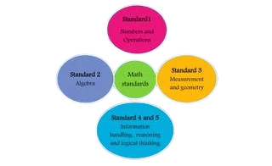
Mathematics Curriculum
15 Minutes
Key Terms used in
Mathematics Curriculum

Slide 8
Mathematics Curriculum - Standards
15 Minutes
Standards describe, in general terms, what all students should study, and they should be able to demonstrate from Grade 1 to Grade 12.

Slide 9
Mathematics Curriculum - Benchmark
15 Minutes
Benchmarks further elaborates on standards and describe, in some detail, the skills students should be able to demonstrate at appropriate development level, typically by the end of grade 3,5,8,10,12.

Slide 10
Mathematics Curriculum - SLOs
15 Minutes
Student Learning Outcomes (SLOs) help to ‘unpack’ a benchmark by describing, in greater detail, the skills students should be able to demonstrate at each grade level for the Benchmark.

Slide 11
Mathematics Curriculum - Objectives
15 Minutes
Learning Objective defines the purpose of the lesson. A well written Learning Objective lays the foundation for a great lesson.

Slide 12
1. Students will be able to demonstrate knowledge of place value (up to 6- digit numbers); represent whole numbers with words, diagrams, number lines, or symbols; order and compare numbers.
15 Minutes
2. Identify the number on tens and hundreds place
3. Students will be able to count, read, write, compare, order, add, subtract, multiply and divide numbers. They will be able to recognize fractions as part of the whole represent fractions, order and add and subtract fractions. They will be able to solve problems in contexts using appropriate number operations.
4. Recognise the place value of each digit in 6- digit numbers.

Slide 13
1. Students will be able to demonstrate knowledge of place value (up to 6- digit numbers); represent whole numbers with words, diagrams, number lines, or symbols; order and compare numbers. [Benchmark I-III]
15 Minutes
Identify the number on tens and hundreds place [Learning objective-III]
Students will be able to count, read, write, compare, order, add, subtract, multiply and divide numbers. They will be able to recognize fractions as part of the whole represent fractions, order and add and subtract fractions. They will be able to solve problems in contexts using appropriate number operations. [Standard I-XII]
Recognise the place value of each digit in 6- digit numbers [SLO-III]

Slide 14
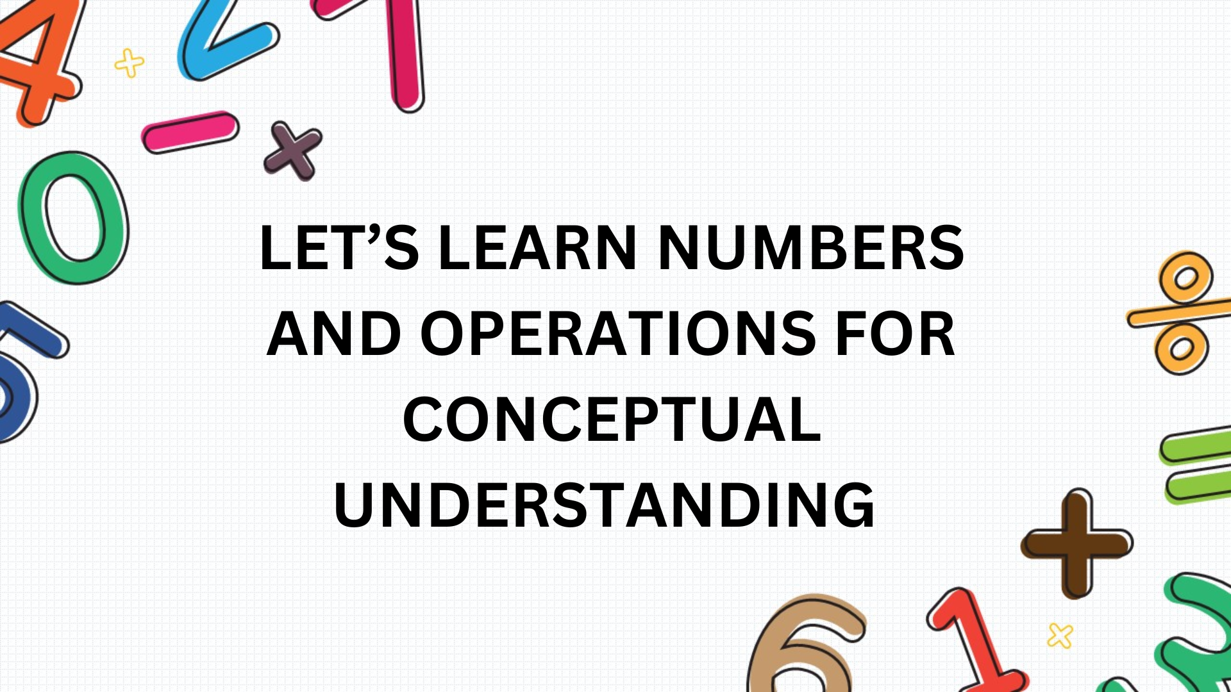
DAY 1

Slide 15

Guess one-digit Number
20 Minutes
Task:
Guess the one-digit number by asking maximum of 8 questions
Ask questions to facilitator for specific place value that can only be answered in YES or NO
Based on facilitator’s response, write for each correct guess of a digit in the appropriate box
Continue until all three digits of the number are correctly guessed
Example of the Questions:
Is the greater than 5? NO
Is the an even number? YES
Is the less than 3? NO
One who says “Number is 4’ is the winner

Slide 16
Guess the 3-digit Number
20 Minutes
Task:
Guess the 3-digit number by asking maximum of 8 questions
Ask questions to facilitator for specific place value that can only be answered in YES or NO
Based on facilitator’s response, write for each correct guess of a digit in the appropriate box
Continue until all three digits of the number are correctly guessed
Example of the Questions:
Is the digit in the hundreds place greater than 5? NO
Is the digit in the hundreds place an even number? YES
Is the digit in the hundreds place greater than 3? YES

Slide 17
Learning Outcomes of the day!
05 Minutes
By the end of the day participants will be able to:
Identify the pre-base-ten understanding based on a count-by one’s approach to quantity (sticks)
Explore different ways to read the numbers using place value blocks
Identify and write two-digit and three-digit numbers using concrete and pictorial representation
Recognize the value of the digit using a place value chart
Use manipulatives (e.g., sticks, money, base ten blocks) to represent place value
Read and write up to 12-digit numbers using billion, million, thousand, and ones
Design and implement a lesson plan on BOPPPS template that effectively conveys addition and subtraction using grouping and regrouping with sticks, money and place value blocks

Slide 18
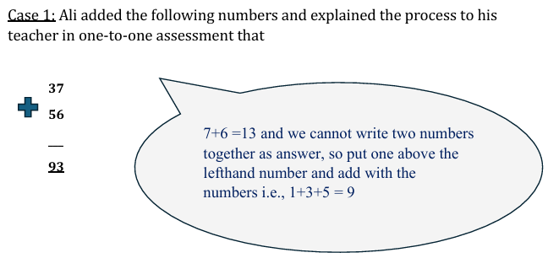
Pre-Assessment- Ali’s Response
20 Minutes

Slide 19
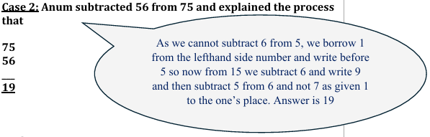
Pre-Assessment- Anum’s Response
20 Minutes

Slide 20
Pre-Assessment
20 Minutes
Task:
What can you say about their understanding of the place value?
2) What feedback (if any) you would give to Ali and Anum?
3) What are the appropriate terms to be used for such tasks?

Slide 21
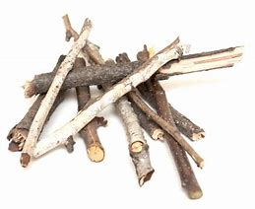
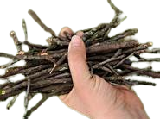
Pre-place value concept: Bundle and Stick Activity
40 Minutes
Task 1:Estimate and write the number of sticks
Task 2: What strategies can you use to count them comfortably?
Task 3: Demonstrate your strategy of counting

Slide 22
Pre-place value concept: Bundle and Stick Activity
40 Minutes
Let’s watch a video
https://www.youtube.com/watch?v=hOLqlmJBVGk

Slide 23
Pre-place value concept: Bundle and Stick Activity
40 Minutes
Task 4:
Use the sticks to solve and demonstrate to the class.
i) 22 + 13
II) 25 - 23
iii) 21 + 19
iv) 15 - 8

Slide 24
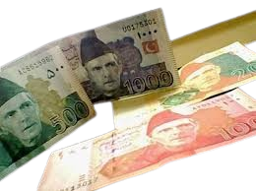
Place Value Concept: Using Pakistani Currency
40 Minutes
How can currency help us understand the concept of
place value in everyday life?

Slide 25

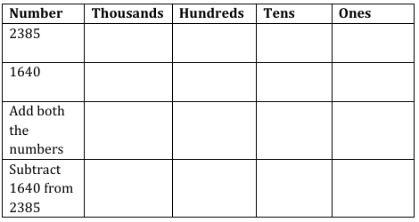
Place value concept: Using Pakistani Currency
40 Minutes
Task:
Complete the place value charts by
placing currency notes in appropriate
column

Slide 26
Place value concept: Using Pakistani Currency
40 Minutes
Discuss strengths and challenges that might arise in the classroom- when currency notes are used to teach place value concept.

Slide 27
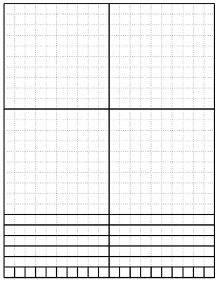
Place value concept: Using Place Value Blocks
40 Minutes
Task 1:
Cut base-ten resources
(Hundreds, tens, and ones).
(Annexure 3)

Slide 28
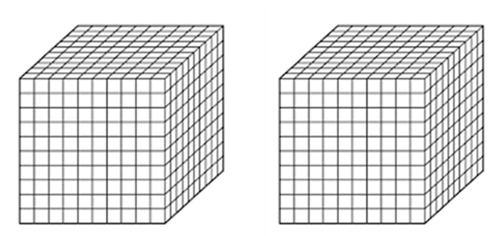
Place value concept: Using Place Value Blocks
40 Minutes
Task 1:
Cut base-ten resources
(Thousands).
(Annexure 3)

Slide 29
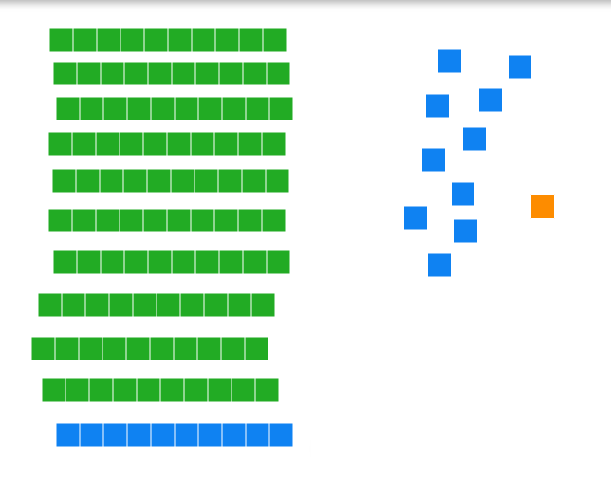
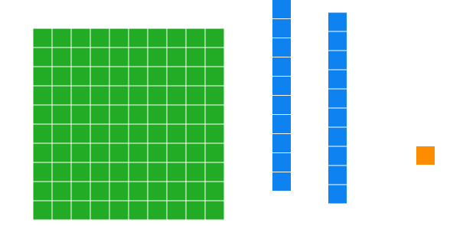
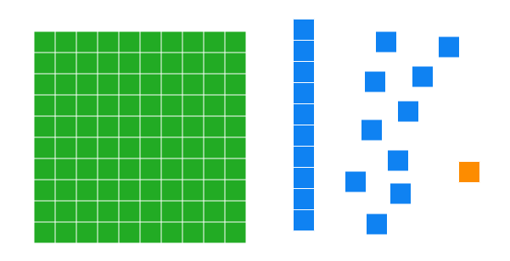
Different Representations of 121

Slide 30
Different Representations of 121
https://polypad.amplify.com/p#number-tiles

Slide 31
Place value concept: Using Place Value Blocks
40 Minutes
Task 3:
Work in groups and make different representations of ‘25’ using base-ten material/ online

Slide 32
Visualizing Bigger Numbers
Let’s watch a video:
https://www.tiktok.com/@reason4math/video/7411220445934177582

Slide 33
Place value- Riddles (Task 4)
40 Minutes
I have 23 ones and 4 tens. Who am I?
I have 4 hundreds, 12 tens and 6- ones. Who am I?
I have 30 ones and 3 hundreds? Who am I?
I have 4 hundreds, 16 tens and 11 ones. Who am I?
I am 340. I have 24 tens. How many hundreds do I have?
If you put three more tens with me, I would be 125. Who am I?

Slide 34
Place value – Mental Math (Task 5)
40 Minutes
1. Use the fact you already know to help you solve each of the following facts without counting
6+ 6 = 12
6 + 7 = _____
6+ 8 = ______
2. Use the fact you already know to help you solve each of the following facts without multiplying
2 × 8 = 16
3 × 8 = _______
6 × 8 = _____
7 × 8 = _______

Slide 35

Planning a learning activity [BOPPPS]- Group Work
20 Minutes
Look at BOPPPS Planning Template (Annexure 4)
Design real life word problems (10 minutes task)

Slide 36
Planning a learning activity [BOPPPS]
40 Minutes
Multiple representation of numbers [ using sticks]
Multiple representation of numbers [ using Currency notes]
Multiple representation of numbers [ using place value blocks]
Adding numbers [with regrouping using sticks]
Adding numbers [with regrouping using Currency notes]
Adding numbers [with regrouping using place value blocks]
Subtracting numbers [with regrouping using sticks]
Subtracting numbers [with regrouping using Currency notes]
Subtracting numbers [with regrouping using place value blocks]
Mental mathematics – compensation strategy / given facts

Slide 37
Micro-Teaching [BOPPPS]-10 minutes
110 Minutes
Reflection
Constructive Feedback
Way Forward

Slide 38

Read and Write up to 12 digit numbers
25 Minutes
Task1
Read the number given on the place value grid

Slide 39
Read and Write upto 12 digit numbers
25 Minutes
Correct way to read is
Four billion, twenty eight million, three hundred sixty thousand, four hundred i.e., not to use ‘and’ when reading the whole number. ‘and’ is used when we read decimal numbers
Now, read 5,217,364,958 using place value grid

Slide 40
Read and Write up to 12 digit numbers
25 Minutes
Task 2
Complete annexure 5 in your respective groups

Slide 41
Exit Ticket
15 Minutes
Reflect your learning of the day on Exit Ticket (Annexure 6)
Handover the Ticket to your facilitator

Slide 42
Home Task
Interview with carpenter/Labourer
The interview should focus on how they use angles in their work.
The suggested questions are given in Day 2 Plan

Slide 43


Slide 44
