Slide 1
Baluchistan Student Learning Improvement Programme [BSLIP]
Agha Khan University
Institute for Educational Development

Slide 2

Recitation of the Holy Quran
03 Minutes

Slide 3
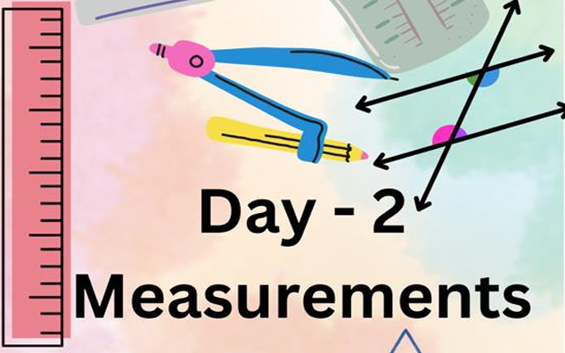
DAY 1

Slide 4
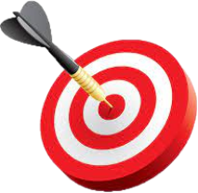
Learning Outcomes of the day!
05 Minutes
By the end of the day participants will be able to:
Connect daily life experience of different professional use of angles in their work.
Explore children’s misconceptions in measurement.
Use non-standard units of measurement which helps them understand the concept of measurement and the importance of consistency;
identify the appropriate unit of measurement in angle, length, weight, and volume;
Convert between units of measurements using the metric system for length, weight, and volume;
Apply their learning about units of measurement in daily life situations.

Slide 5

Homework Task Discussion
15 Minutes
Task:
With reference to the interview you have conducted discuss within your group and then share:
How do these professionals determine angles without using formal measuring tools, like protractors?
What challenges might arise if angles are not measured or estimated correctly while exploring angles in school curriculum?

Slide 6
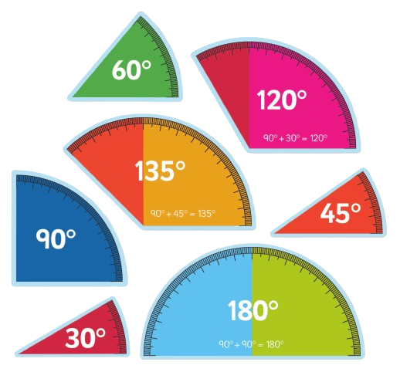
Part A: Developing Geometric Thinking
Angles

Slide 7
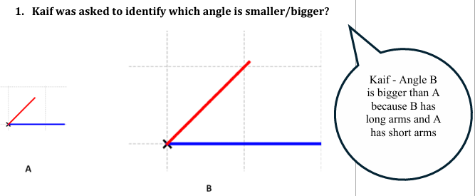
Pre-Assessment – Concept of Angle A. Is Kaif’s thinking appropriate?
10 Minutes

Slide 8
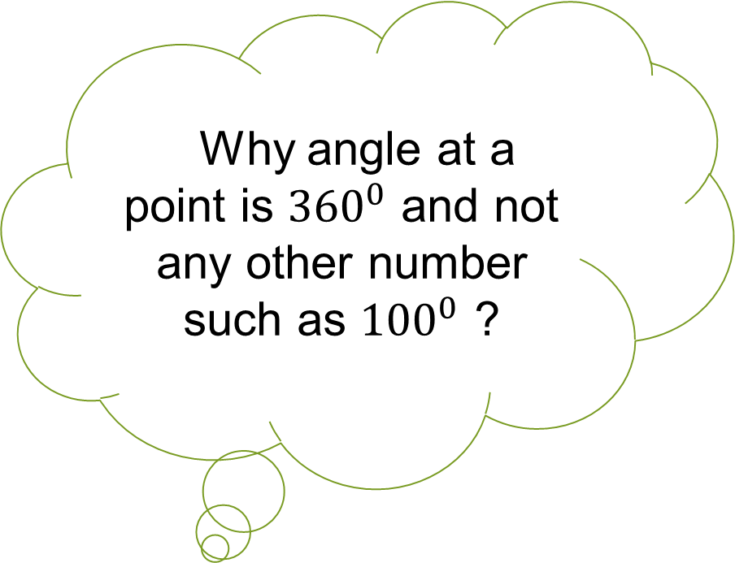
Pre-Assessment
10 Minutes
le Why angle at a point is ${360}^{0}$ and not any other number such as ${100}^{0}$ ?

Slide 9
Pre-Assessment
10 Minutes
Let’s watch a video
https://www.youtube.com/watch?v=WzkW3P7HPvs

Slide 10
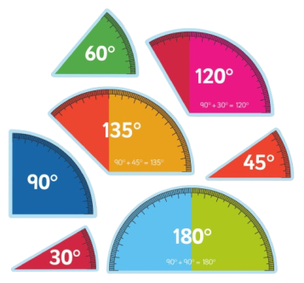
Angles
05 Minutes
le How would you define an Angle?
le How would you measure an angle?

Slide 11
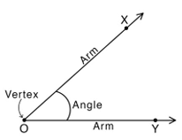
Angles
05 Minutes
Angle:
An angle is defined as a figure that forms when two rays meet at a common point. It is represented by the symbol ∠.
Angle is measured in degrees. A degree is measure of rotation.
Angle has three parts:

Slide 12
Understanding that Rotation Matters, Not the Length of the Arms
20 Minutes
Task:
Draw an angle on the floor
The facilitator stands at the vertex
Two participants stand on the arms of the angle close to the vertex
The facilitator then rotates his/her hand from one participant to the other
The participants will move away from the vertex while staying on the same arms
The facilitator again rotates his/her hands from one participant to the other, noting that the degree of rotation remains the same
Do a similar experiment and demonstrate the concept of angle

Slide 13
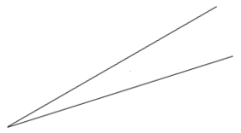
Angle Measurement: Non-Standard Unit of Measure
30 Minutes
Task:
Design a non-standard unit to measure angles using scale and a transparent thick plastic/paper
Measure a set of angles given in the handout (Annexure 1) by placing your designed unit at the vertex of each angle
Count how many of your units fit within the angle
If the unit does not fit perfectly, you can estimate or calculate fraction of your unit
Show your unit of measurement and angles measured in your group
Discuss the relationship between unit of measurement and the measurement of angle
Share your findings with the whole class

Slide 14
Design a Paper Protractor
40 Minutes
Let’s make a paper protractor

Slide 15
Design a Paper Protractor
40 Minutes
Step 1: Cut a semicircle from the handout (annexure 4)
Step 2: Fold the base i.e., touch both the end and now the
semicircle is divided into two equal parts with a
crease.

Slide 16
Design a Paper Protractor
40 Minutes
Step 3: Open it and write ‘90’ on the midpoint and mark it as
the center point ‘O’.
Step 4: Draw the Baseline: Draw a straight line across the
diameter of the semicircle.
Step 5: Write the degree values 0° and 180° along the edges of
the semicircle

Slide 17
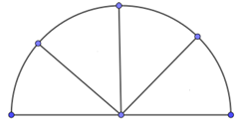
Design a Paper Protractor
40 Minutes
Step 6: Second, fold the half semicircle into further half
keeping the same. Open the semicircle and now you
see two more creases as shown below.

Slide 18
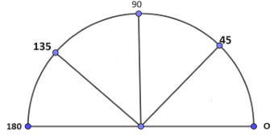
Design a Paper Protractor
40 Minutes
Step 7: Label the crease as follows (hint - half of 90° is 45°)

Slide 19
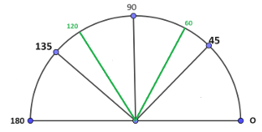
Design a Paper Protractor
40 Minutes
Step 8: Now open the semicircle and from the vertex as center fold in such a way to get three equal parts. Label them as follows

Slide 20
Design a Paper Protractor
40 Minutes
Step 9: Try to make 30° and 150° and share the steps with
the class.
Step 10: Use your paper protractor to mark key angles such
as 30°, 45°, 60°, 90°, 120°, 135° and 150°.

Slide 21
Design a Paper Protractor
40 Minutes
Step 11: Use your paper protractor to draw the following:
1. ∠PQR = 30°
2. ∠MNO = 45°
3. ∠XYZ = 150°
Step 12: Measure the angles (Annexure 1) using paper protractor.
You may write the estimate if you don’t find the exact measure in the protractor

Slide 22
Measuring Angle With Protractor
05 Minutes
Let’s learn to measure the angles
https://studyjams.scholastic.com/studyjams/jams/math/geometry/measure-angles.htm

Slide 23
How to Draw Angles
25 Minutes
Let’s learn to draw the angles
https://studyjams.scholastic.com/studyjams/jams/math/geometry/construct-angles.htm
Tasks:
Measure the angles in the handout (Annexure 3) using standard protractor.
2. Use textbook tasks to draw a few angles using standard
protractor

Slide 24
Types of Angles
10 Minutes
Tasks:
Refer to mathematics textbook to define
Acute angle
Obtuse angle
Right angle
Straight angle
Reflex angle
2. In the handout (Annexure 3) add the type of angle based on the
angle measurement

Slide 25
Constructing a Triangle when ASA (Angle Side Angle) is given
20 Minutes
Tasks:
Identify ASA tasks from the grade V mathematics textbook and draw a few and label them

Slide 26
Home Task
Tasks:
Measure angles greater than 180° using a 360° circle protractor. Mark the angles – both inner and outer side of the
protractor

Slide 27
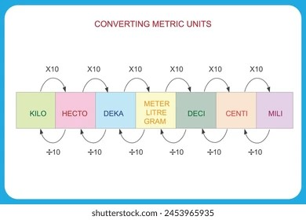
Part B: Units of Measurement

Slide 28
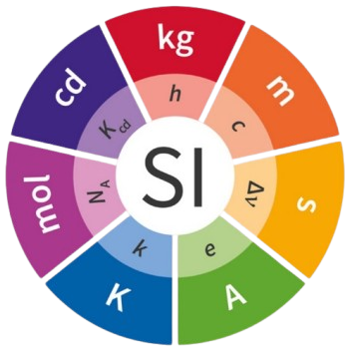
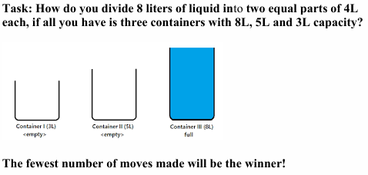
Problem Solving and Logical Thinking
20 Minutes

Slide 29
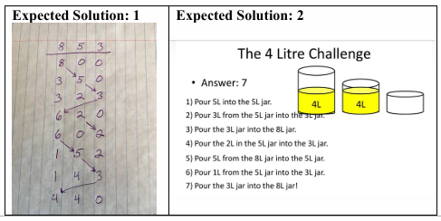
Problem Solving and Logical Thinking
20 Minutes

Slide 30
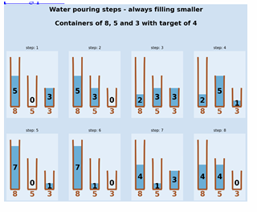
Problem Solving and Logical Thinking
20 Minutes

Slide 31
Identification of Units of Measurement
20 Minutes
Let’s watch a video
https://studyjams.scholastic.com/studyjams/jams/math/measurement/units-of-measurement.htm
Keep in mind the following questions while watching the video
What are the four units of measure?
How do you define measurement?
What kind of problems the world would face without proper measurement?
What is the Metric SI system of measurement?

Slide 32
Identification of Units of Measurement
20 Minutes
Discuss the responses in the group and share one key learning with the class
Complete annexure 2 – first estimate the length and then measure using standard unit.

Slide 33
Conversion of Units of Measurement
35 Minutes
Think of the solution of the following problems and reflect on how you arrive at the solution:
1. Arrange the given measurement in ascending order 3 kilograms;
3004 gram 301,000 centigrams 2,999,999 milligrams.
[whole class discussion]

Slide 34
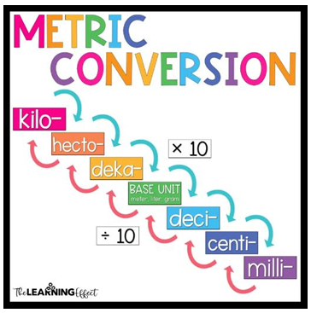
Conversion of Units of Measurement
35 Minutes
Discuss in your groups the
Following diagram, determine
the process of conversion of
units and explain with the whole
class:

Slide 35
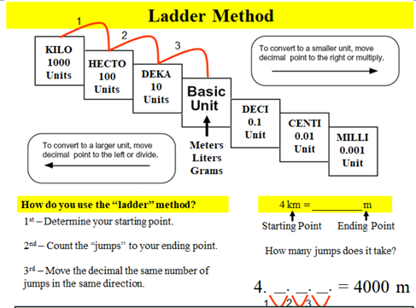
Conversion of Units of Measurement
35 Minutes
Let’s learn
How to convert units of
measurement:

Slide 36
Conversion of Units of Measurement
35 Minutes
2. Sarah wants to bake cookies for her school’s bake sale. The recipe requires 50 milligrams of sugar for each batch. Sarah has one kilograms of sugar at home. How many batches of cookies can Sarah bake?

Slide 37
Conversion of Units of Measurement
35 Minutes
3. Jamila is participating in a bike race that covers 6 kilometers. Her younger brother asks him how far that is in meters because he has learnt measuring distance in meters in his mathematics class. So how many meters are to be covered in the bike race?

Slide 38
Conversion of Units of Measurement
35 Minutes
4. Sikander’s mother asks him to buy 3 liters of orange juice. However, the store only has juice bottles of 250 milliliters. How many 250-milliliter bottles should Sikander buy to have 3 liters of juice?

Slide 39
Conversion of Units of Measurement
35 Minutes
5. Salim is planting flowers in his garden. He has a garden bed that is 3 meters long. Each flower needs to be planted 30 centimeters apart. How many flowers can Salim plant along the length of the garden bed?

Slide 40
Conversion of Units of Measurement
35 Minutes
6. Dr. Ahmed requires 5 milliliters (ml) of medication for each patient. The total medicine administered is 2 centiliters (cl). How many patients visited Dr Ahmed’s clinic?

Slide 41
Measurement in Real Life
30 Minutes
Task
Complete the table given in Annexure 5 by choosing appropriate unit of measurement and convert them into one of your choice
Share your responses and reflect on the activity that how this activity can help children in comprehend the concept and process of unit conversions
Discuss the importance of choosing appropriate units of measuring different objects in real life

Slide 42
Summary and Reflection
10 Minutes
Reflect on the following questions and share your thoughts with the whole class:
What are some real-life examples where you need to choose the correct unit of measurement?
Which units of measurement were most familiar to you, and which were new or challenging?
How did you approach converting units? Was there a particular conversion that was tricky?

Slide 43


Slide 44
