Slide 1
Baluchistan Student Learning Improvement Programme [BSLIP]
Aga Khan University
Institute for Educational Development

Slide 2

Recitation of the Holy Quran
03 Minutes

Slide 3
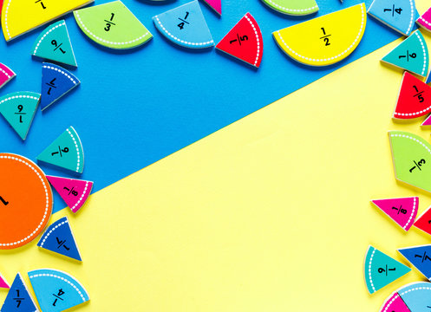
Day - 3
Fractions

Slide 4
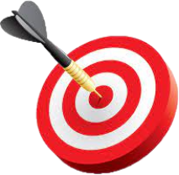
Learning Outcomes of the day!
05 Minutes
By the end of the day participants will be able to:
recognize and articulate how an understanding of ‘unit’ supports students in comprehending both proper and improper.
explore and create multiple visual representations using sticks, money and area models to illustrate both proper and improper fractions
explain and apply methods for identifying and computing equivalent fractions, focusing on simplifying fractions and determining equivalence using visual model using paper folding.
perform operations with two or more fractions, solving problems that involve different contexts and types of fractions (proper, improper, and mixed numbers)
solve real-life problems that involve fractions, and design similar tasks that can be used to contextualize fractions to apply them in everyday situations

Slide 5
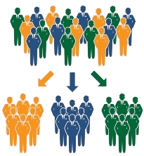
Grouping Strategy
20 Minutes
Pick a piece of paper from a bowl, read it and, identify the group that corresponds to the benchmark.

Slide 6


Slide 7
Grouping Strategy
20 Minutes
Compare the fractions within your group to ensure you all align with the given benchmark.

Slide 8
Grouping Strategy
20 Minutes
Discuss the strengths of this activity such as appropriate for mental math with whole class/individuals
List ways of adopting/modifying the activity to be implemented in the real classroom

Slide 9
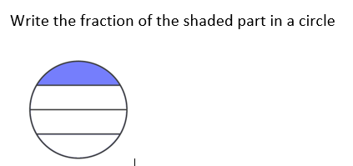
Pre-Assessment

Slide 10
Pre-Assessment
Correct answer:
As parts are not equal, we cannot write the fraction

Slide 11
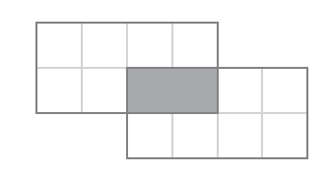
What Part is Shaded?

Slide 12
What Part is Shaded?
Two-eighth One -fourth
Two-eighth One -fourth
Two-fourteenth One-seventh

Slide 13
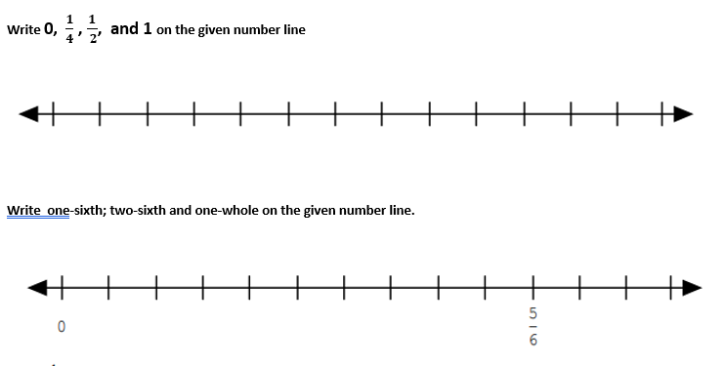

Slide 14
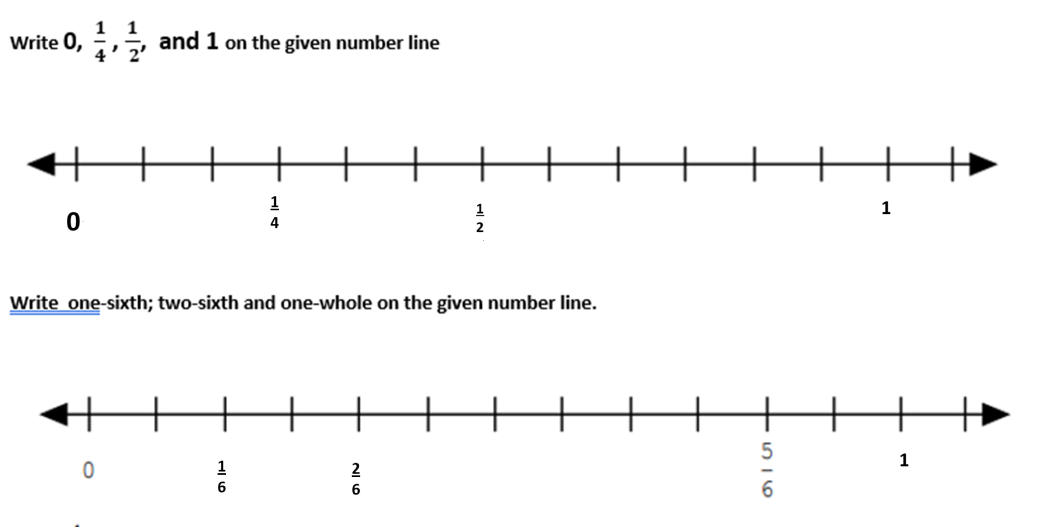
Correct Representation

Slide 15
Key Message
Understand the task;
Visualize / imagine what is happening;
Recheck your response to ensure that the answer is realistic.

Slide 16
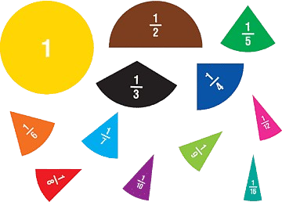

Equivalent Fractions
45 Minutes
Let’s make a Equivalent Fractions chart from paper:
Step 1: Take a A4 size paper and fold it lengthwise to show half (one crease).

Slide 17
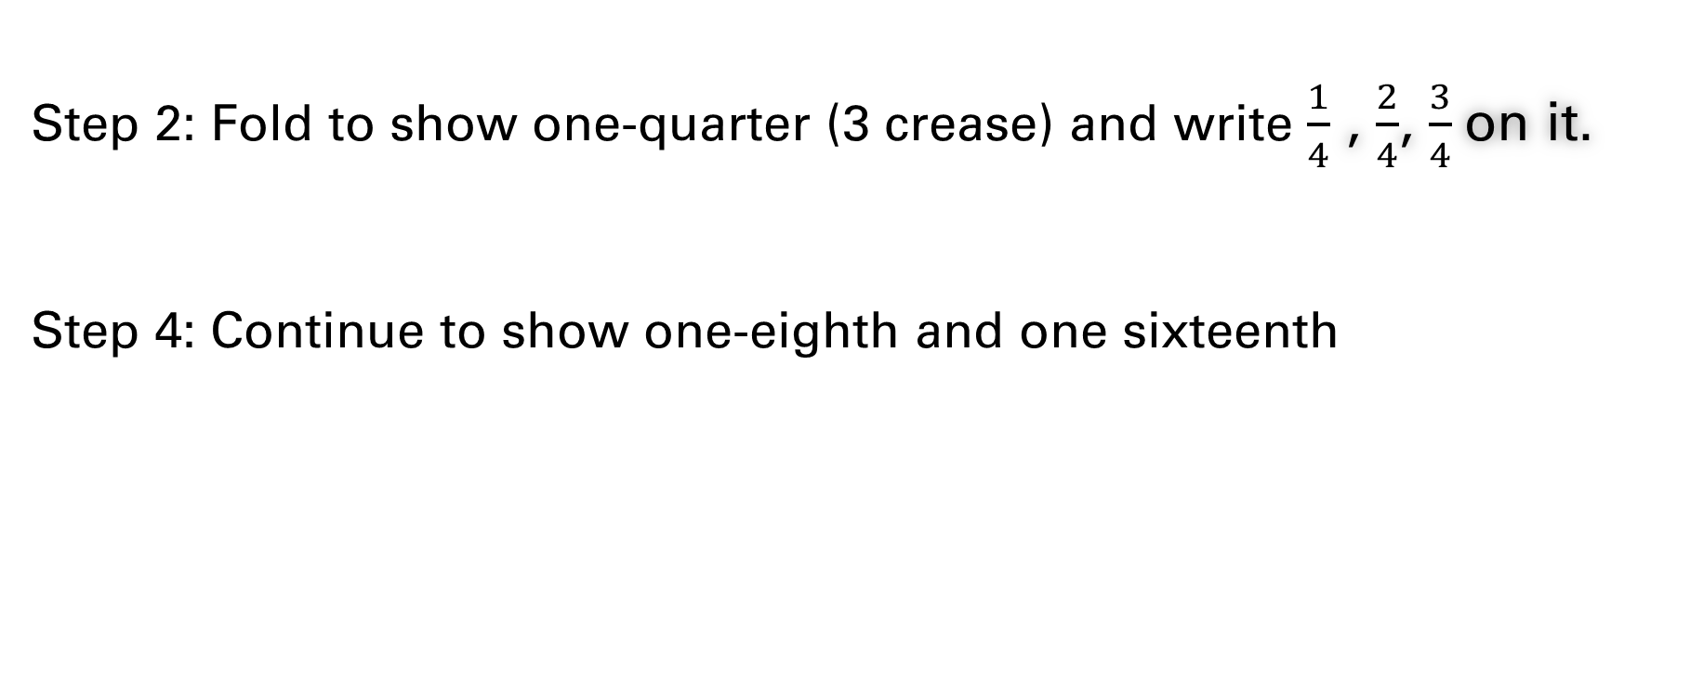
Equivalent Fractions
45 Minutes
Step 2: Fold to show one-quarter (3 crease) and write $\frac{1}{4}$ , $\frac{2}{4}$, $\frac{3}{4}$on it.
Step 4: Continue to show one-eighth and one sixteenth

Slide 18
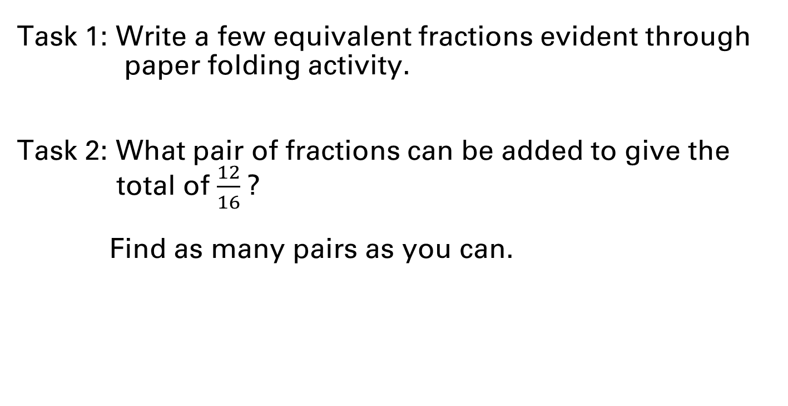
Equivalent Fractions
45 Minutes
Task 1: Write a few equivalent fractions evident through
paper folding activity.
Task 2: What pair of fractions can be added to give the
total of $\frac{12}{16}$?
Find as many pairs as you can.

Slide 19
Equivalent Fractions
45 Minutes
Let’s watch the video to understand equivalent fractions:
https://www.youtube.com/watch?v=PVFyMSgqrUw

Slide 20
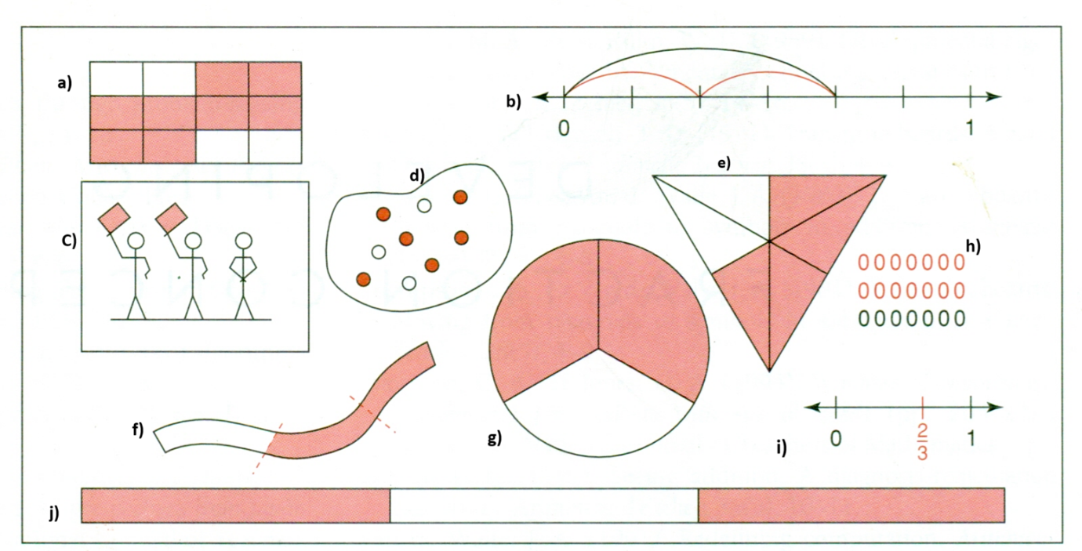
Categories the given model into three – area model, line model , set model

Slide 21
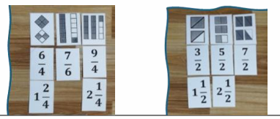
Fractions Greater Than 1
20 Minutes
Create a set from the given cut-outs, where each improper fraction is represented both symbolically and pictorially

Slide 23
Adding Like Fractions
20 Minutes
Task
Asif had two-ninth kilogram of chopped walnuts. Anam brought four-ninth kilogram of chopped walnuts. How many kilograms of chopped walnuts did they have together?
Show this using area model

Slide 24

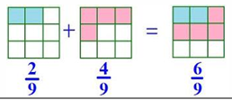
Adding Like Fractions
20 Minutes

Slide 25

Subtracting Like Fractions
20 Minutes
Task
Solve using area model
$\frac{5}{9}$ - $\frac{3}{9}$

Slide 26
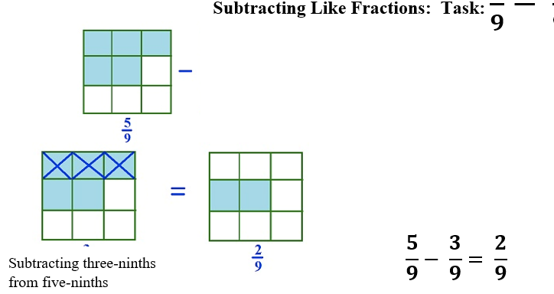
Subtracting Like Fractions
20 Minutes

Slide 27
Add Unlike Fraction
$\frac{2}{3}+\frac{1}{5}$

Slide 28
Add Unlike Fractions – Equivalent Fraction
$\frac{2}{3}$ , $\frac{4}{6}$ , $\frac{6}{9}$ , $\frac{8}{12}$ , $\frac{10}{15}$ , $\frac{12}{18}$ , $\frac{14}{20}$
$\frac{1}{5}$ , $\frac{2}{10}$ , $\frac{3}{15}$ , $\frac{4}{20}$ , $\frac{5}{25}$ , $\frac{6}{30}$ , $\frac{7}{35}$
$\frac{10}{15}$ + $\frac{3}{15}$ = $\frac{13}{15}$

Slide 29
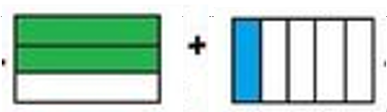
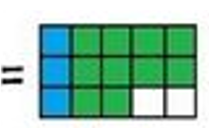
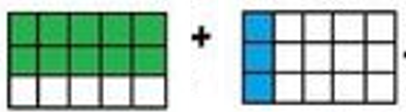
Add Unlike Fraction – Area model $\frac{2}{3}+\frac{1}{5}$

Slide 30
Least Common Multiple Method
$\frac{1}{5}$ + $\frac{2}{3}$
Step 3 = $\frac{13}{15}$
Step 1 = $\frac{1\left(3\right)+2(5)}{15}$
Step 2 = = $\frac{3 +10}{15}$

Slide 31
Adding Unlike Fractions
30 Minutes
Task
Asif had one-fifth kilogram of chopped walnuts. Anam brought two-third kilograms of chopped walnuts. How many kilograms of chopped walnuts did they have together?
Use area model to show addition of unlike fractions

Slide 32

Adding Unlike Fractions
30 Minutes
Let’s see how unlike fractions are added:
First draw one-fifth using vertical lines in a rectangular shape figure
Next draw three-fourth using horizontal lines in the same sized rectangular shape

Slide 33
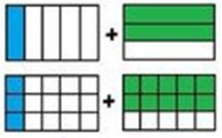
Adding Unlike Fractions
30 Minutes
Let’s see how unlike fractions are added:
Replicate the vertical lines on figure with horizontal lines
Replicate the horizontal lines on figure with vertical lines

Slide 34
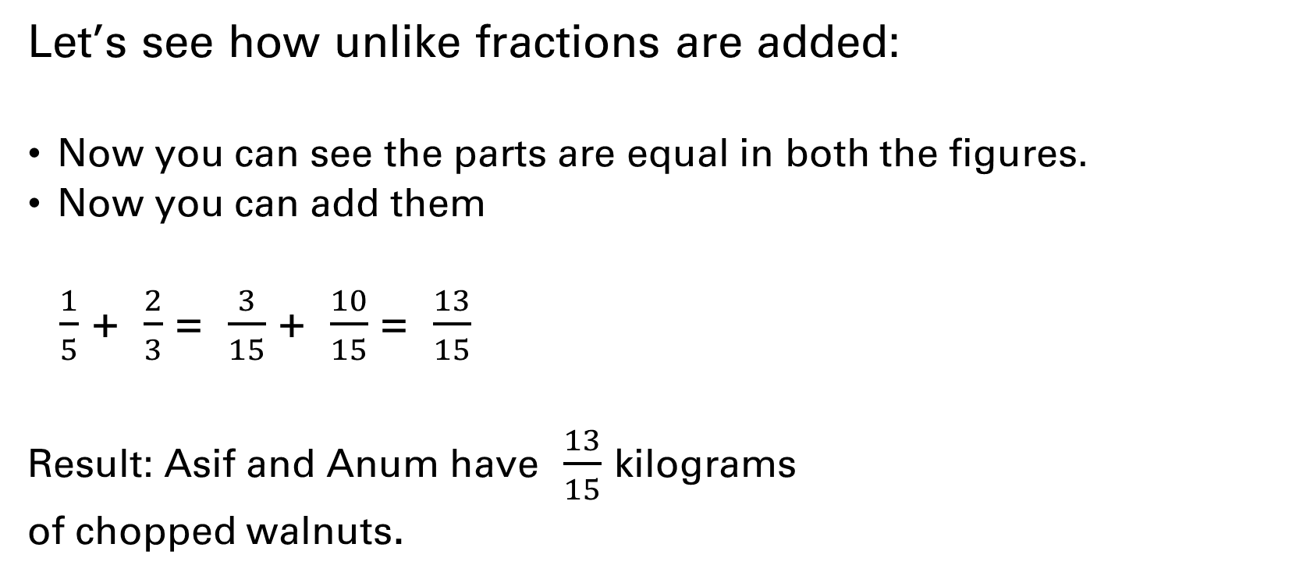
Adding Unlike Fractions
30 Minutes
Let’s see how unlike fractions are added:
Now you can see the parts are equal in both the figures.
Now you can add them
$\frac{1}{5}$ + $\frac{2}{3}$ = $\frac{3}{15}$ + $\frac{10}{15}$ = $\frac{13}{15}$
Result: Asif and Anum have $\frac{13}{15}$ kilograms
of chopped walnuts.

Slide 35
Subtracting Unlike Fractions
20 Minutes
Task
Design two real life problems for subtracting unlike fractions
Solve two of them using area model
Share with the whole class

Slide 36
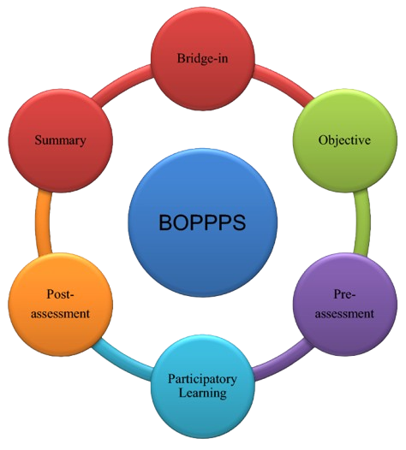
Planning a Learning activity [BOPPPS]
20 Minutes
Let’s make four groups

Slide 37
Planning a Learning activity [BOPPPS]
180 Minutes
Your assigned topic:
Group 1: Numbers & Operations
Group 2: Angles
Group 3: Unit conversions
Group 4: Fractions
Task
Write one concept on a paper strip for assigning
micro-teaching to other groups

Slide 38
Planning a Learning activity [BOPPPS]
20 Minutes
Let’s divide in small groups

Slide 39
Planning a Learning activity [BOPPPS]
180 Minutes
Task
Pick a chit and develop a lesson plan of
5 minutes activity for micro-teaching

Slide 40

Microteaching
180 Minutes
Each group will demonstrate their planning through micro-teaching followed by peer and facilitator’s feedback

Slide 41

Session conclusion/Reflection
180 Minutes
Share two key learning and one suggestion to further strengthening the manual/training

Slide 42


Slide 43
